Slide 1

CU-Event Management System
Project Members :
Harshit Srivastava, 19BCS1142, CSE 2A
Tanmay Tripathi, 19BCS1120, CSE 1C

Slide 2
Project Overview
1. The Research Stage : It was a critical stage that provided our team with the knowledge necessary to complete the other stages of our project. This stage was an ongoing process that our team had to return to many times during the development process to gain the knowledge needed to continue on with the project. Our research encompassed a wide range of sources, which included studies done at diﬀerent universities and hobby enthusiast sources. Our research included topics like HTML. CSS, JavaScript, NodeJS and MongoDB.
2. Building & Interfacing Stage : This stage started when the ordered parts started arriving. During this stage we focused on verifying and testing each and every html, css and JS parts thoroughly. After each part was verified to be working correctly, we combined the components together and front-end part was done.
3. The Programming Stage : In this stage of our project we were to design three different things for our project. They were designing a HTML page, a CSS page and a Javascript page . Unfortunately we did not get very far in this stage and programming for Chatbot and back-end part has yet to be done.

Slide 3
Technology used
1. HTML :
HTML describes the structure of a Web page
HTML elements tell the browser how to display the content
2. CSS :
CSS describes how HTML elements are to be displayed on screen, paper, or in other media
CSS saves a lot of work. It can control the layout of multiple web pages all at once
3. JavaScript :
JavaScript is used to create interactive websites.
Displaying clocks etc.

Slide 4
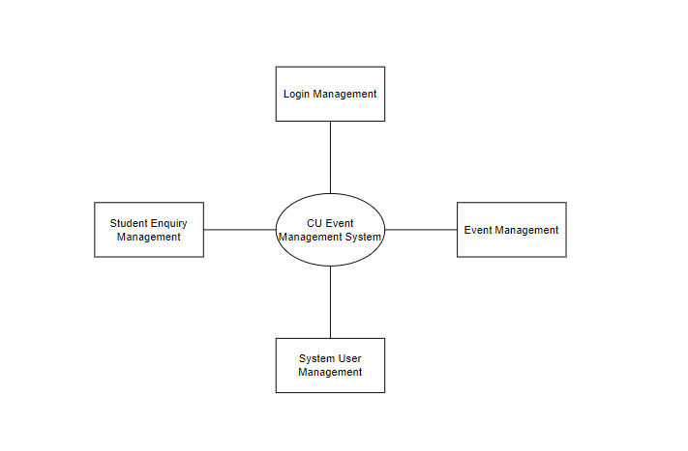
Zero-level DFD for CU-EMS

Slide 5
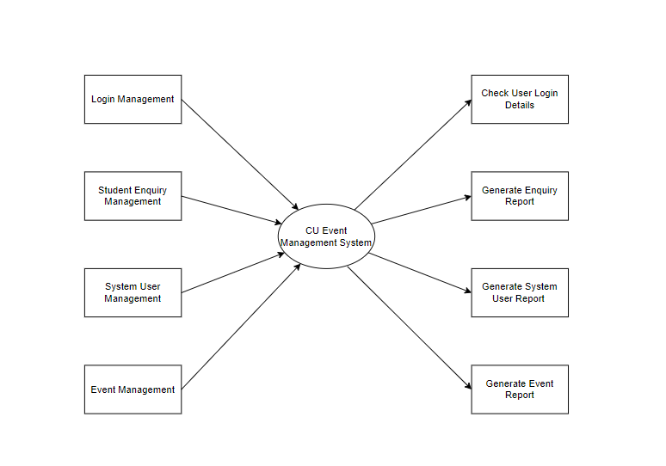
First-level DFD for CU-EMS

Slide 6
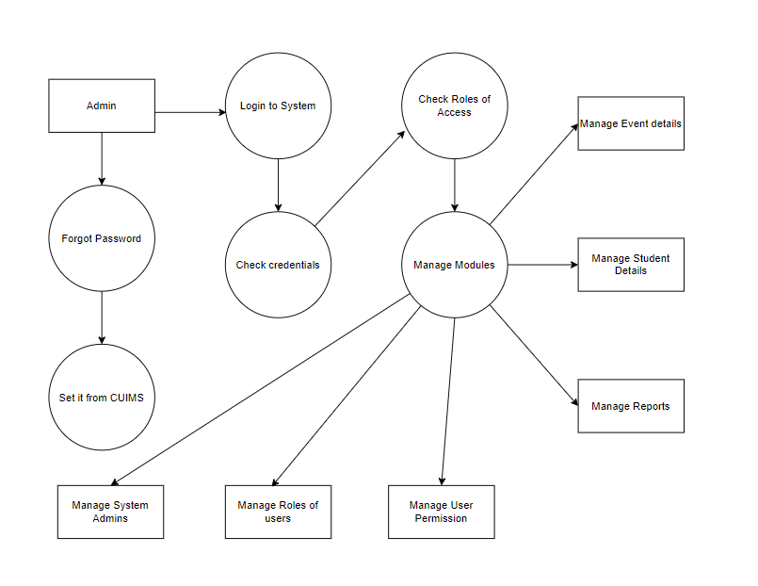
Second-level DFD for CU-EMS

Slide 7
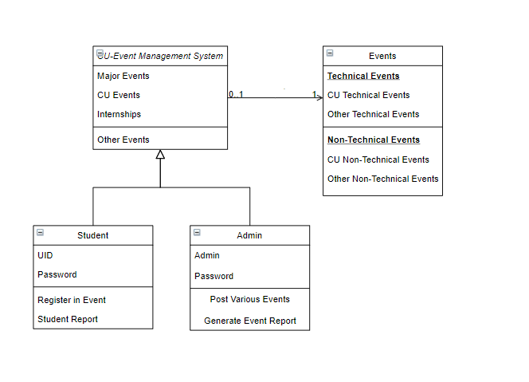
Class Diagram for CU-EMS

Slide 8
Implementation
Navigation bar :
This is navigation bar for CUEMS and the position of it is fixed after scrolling it will be present there. It has divisions of Tech, Non-tech, in campus and cultural, also there is one tab for ADMIN is present in bar which direct to ADMIN page and its backend is still under working.

Slide 9
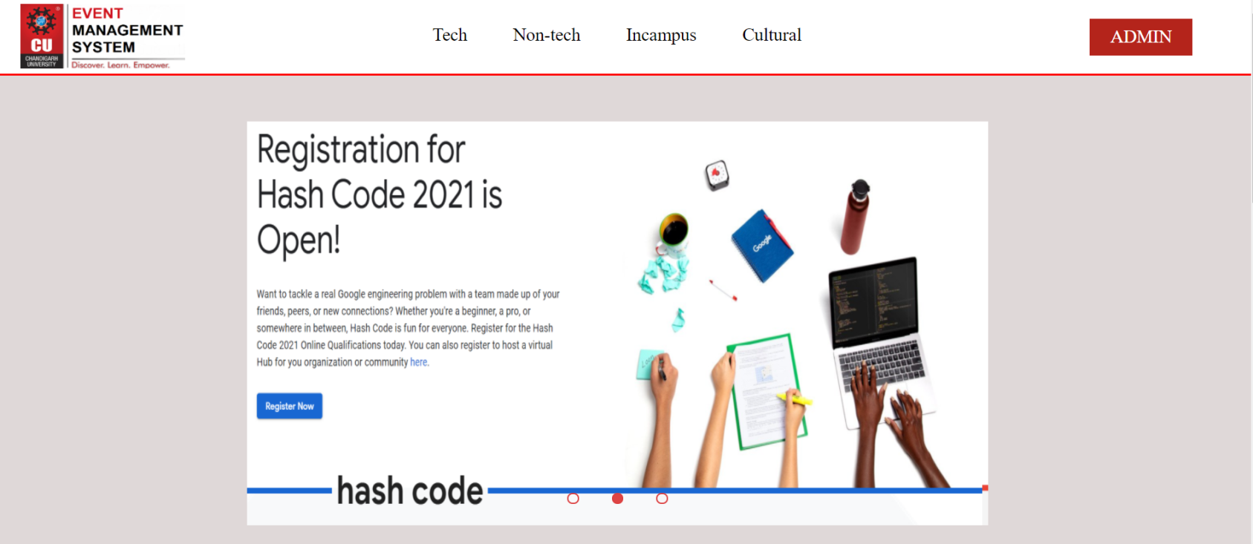
Implementation
SLIDER :
Slider is animated part of webpage; it has all the important events and competitions highlighted in slides and by clicking on it, user direct to competition page. The slides are also animated, and they automatically change to another slide.

Slide 10
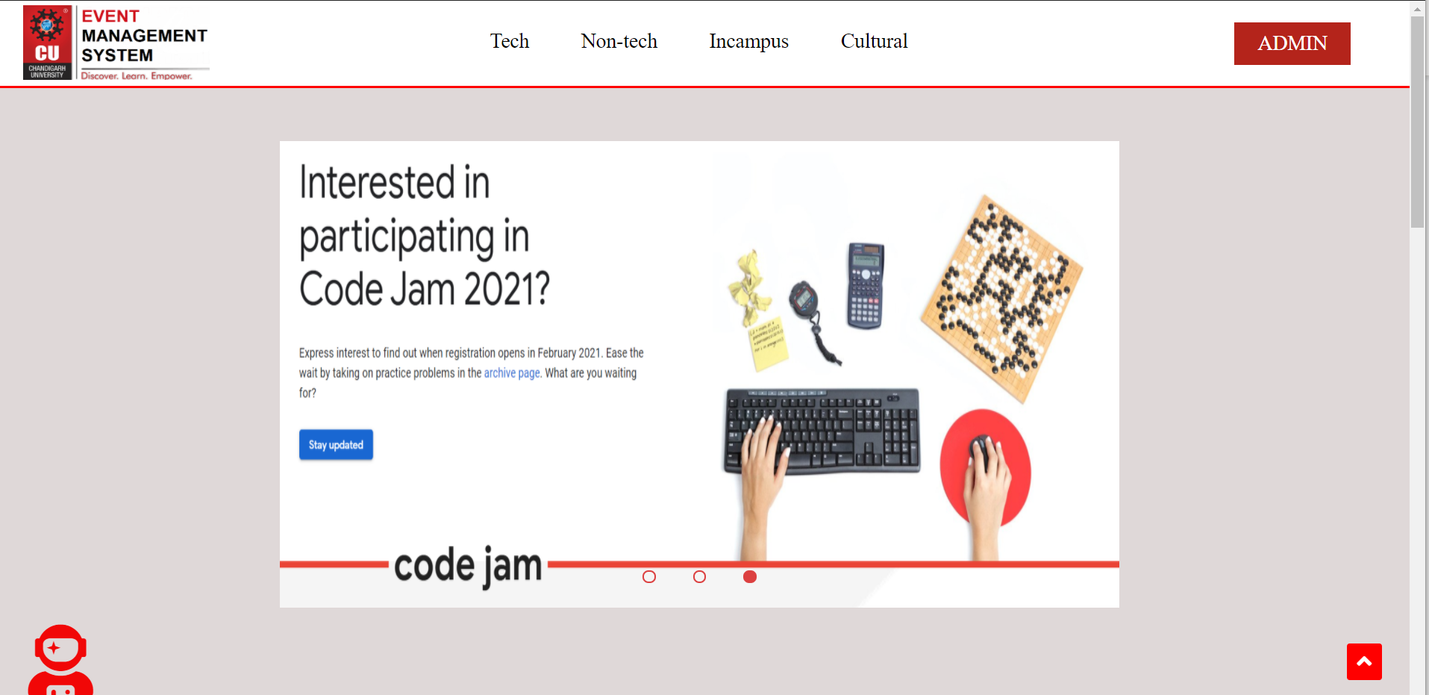
Implementation
Whole page :

Slide 11
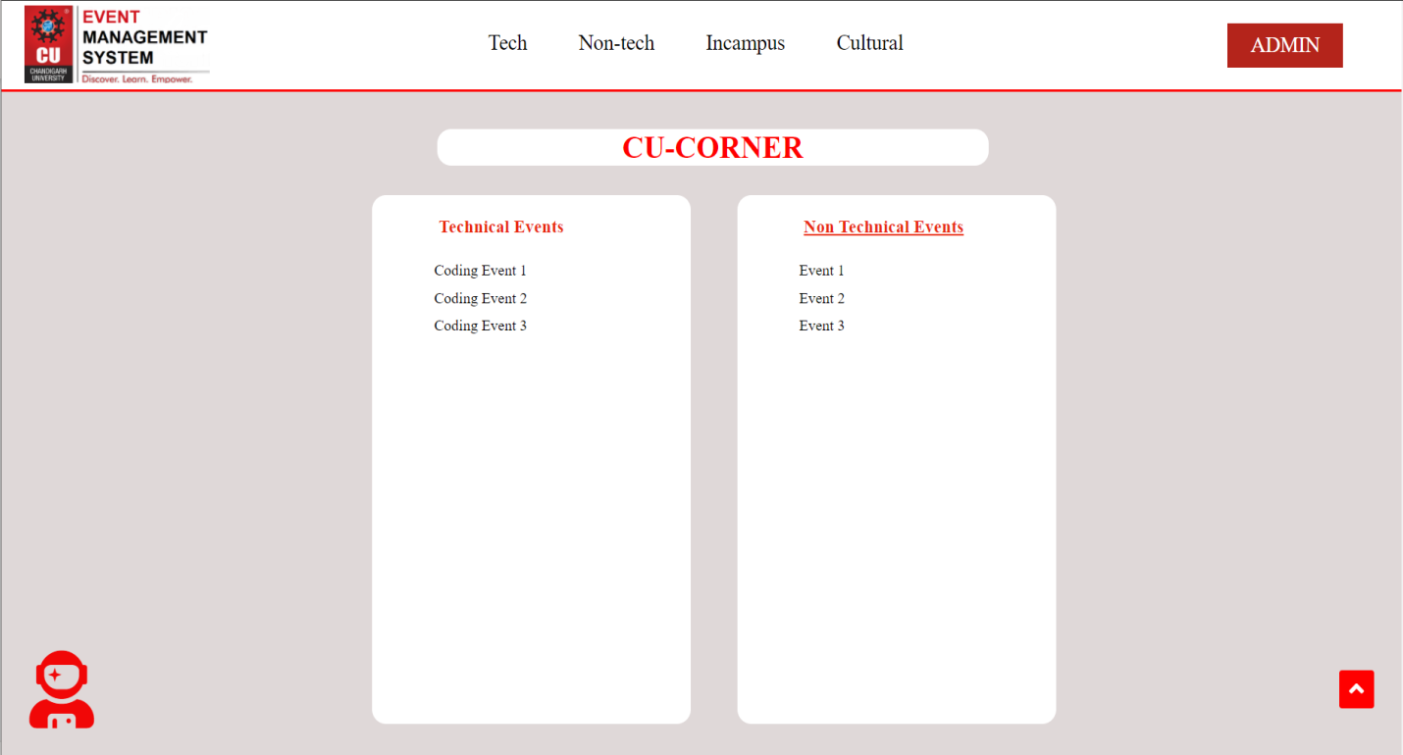
Implementation
CU-Corner :
After scrolling we get to cu corner which have technical and non-technical events section and it needs to be updated and competition needs to be added also their competition tags will be there. After scrolling we get jobs and internship page.

Slide 12
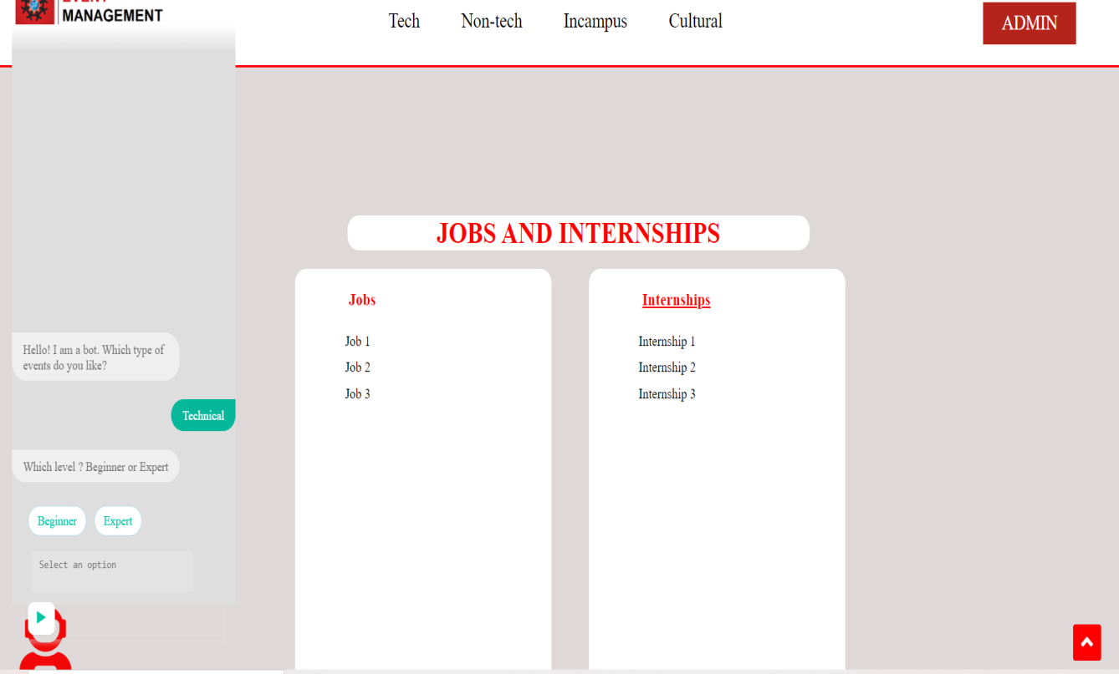
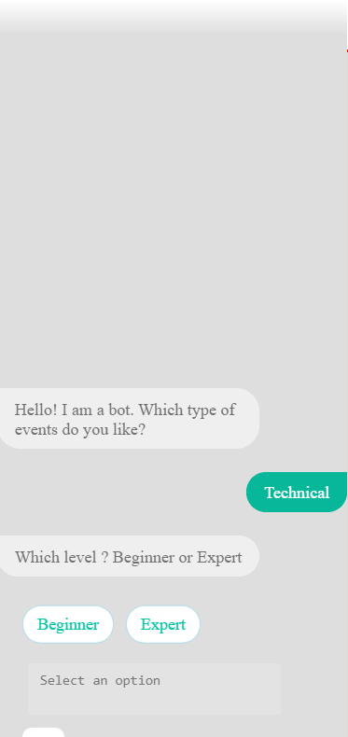
Implementation
Chat Bot :
By clicking astronaut icon on left side page we have chatbot

Slide 13
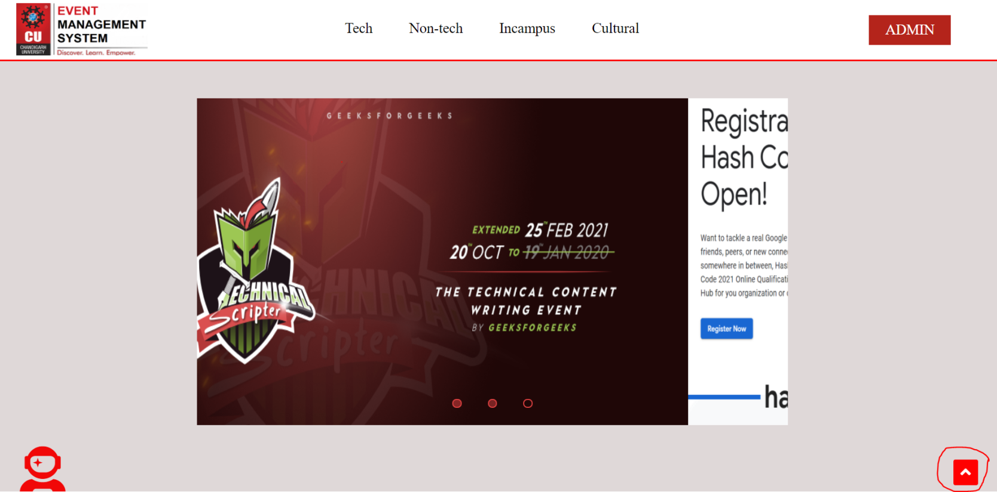
Implementation
Arrow Button :
This arrow button functionality is to move to top of the page when the user scroll down the web page.

Slide 14

Implementation
Footer :
This arrow button functionality is to move to top of the page when the user scroll down the web page.

Slide 15
Conclusion
Chandigarh University Event Management System is a web page initially for students at Chandigarh University for getting them notified about all competitions and events held in college and outside college which are technical and non-technical. Most of you may be familiar with site like sarkariresult.com which I think most of us had used, basically it is like it.
Main aim of this project to link it with college official information management site, and then on that page teachers, organizations and admins can post events and competition on that page by which it become easier for student to get notified and for admins it become easier to manage records.
At last Project is 45% completed.

